Slide 1
Parallel & Distributed Computing
Chapter 1(Continue)
Instructor: Yusra Mansoor
Email: yusra_mansoor@outlook.com

Slide 2
Types of Distributed Systems
Distributed computing systems
Cluster computing systems
Grid computing systems
Cloud computing systems
Distributed Information systems
Transaction processing systems
Enterprise application integration (exchange info via RPC or RMI)
Distributed pervasive systems
Smart-home systems
Electronic Healthcare systems (Heart monitors, Body Area Network)
wireless sensor networks

Slide 3
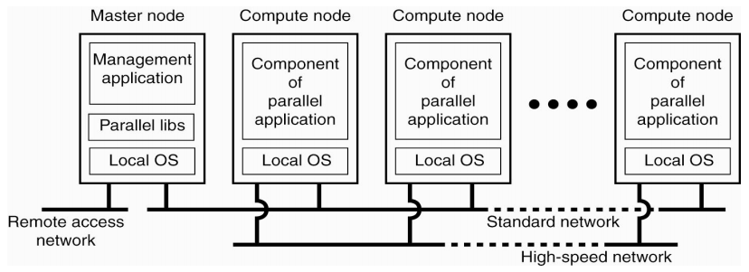
Cluster Computing Systems
Hooking up a collection of simple computers (mostly homogeneous) via high-speed network
To build a supercomputing platform
Example: server cluster at Banks, Brokerages, etc.

Slide 4
Grid Computing Systems
In contrast to cluster computing, grid computing
Have a high degree of heterogeneity
No assumption are made concerning hardware, OS, security, etc.
Users and resources from different organizations are brought together to allow collaboration
Virtual Organization (VO): A Vos defines a group of users/applications that have access to a specified group of resources, which may be distributed across many different computers, owned by many different organizations.
Members belong to the same VO has access to the resources that are provided to that VO
Focus of the software design for grid computing
Provide access to resources from different administrative domain to only those users that belong to a specific VO

Slide 5
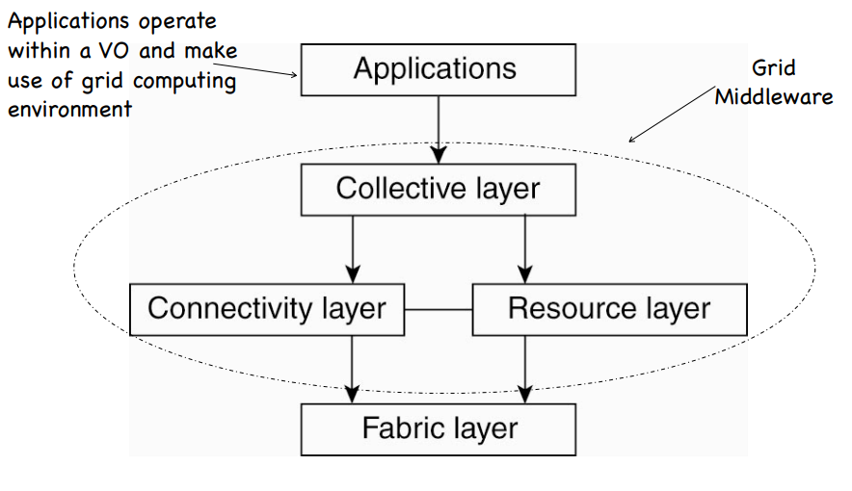
An Example Architecture (1)

Slide 6
An Example Architecture (2)
Fabric layer
Provide interface to local resources as a specific site within a VO
Resource layer
Managing a single resource such as creating a process or read data
Connectivity layer
Transfer data between resources or access a resource from a remote location
Collective layer
Provide access to multiple resources; typically consists of services for resource discovery, allocation and scheduling

Slide 7
Cloud Computing Systems
Computing resources (hardware and software) that are delivered as a service over a network
Cloud computing providers offer their services according to three fundamental models
Infrastructure as a service (IaaS)
Basic infrastructure, clients need to install OS images
platform as a service (PaaS)
Comes with OS, database, web servers
software as a service (SaaS)
Comes with the software that the clients need

Slide 8
Distributed Information Systems
Deal with the interoperability between networked applications
Two forms of distributed info. systems
Transaction Processing System (TPS)
Distributed transaction: all or nothing happened
Enterprise Application Integration (EAI)
Separate process components from databases
Let applications communicate with each other

Slide 9
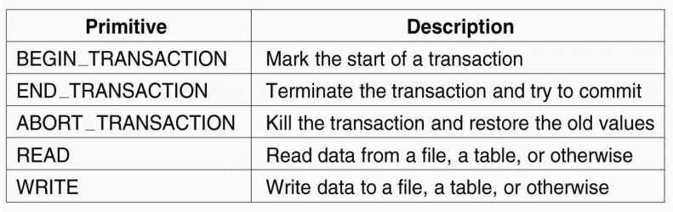
Transaction Processing Systems
Properties of transactions
Atomic: to the outside world, each transaction happens indivisibly
Consistent: the transaction does not violate the system invariants
Isolated: concurrent transactions do not interfere with each other
Durable: once a transaction commits, the changes are permanent
Primitives for transactions:

Slide 10
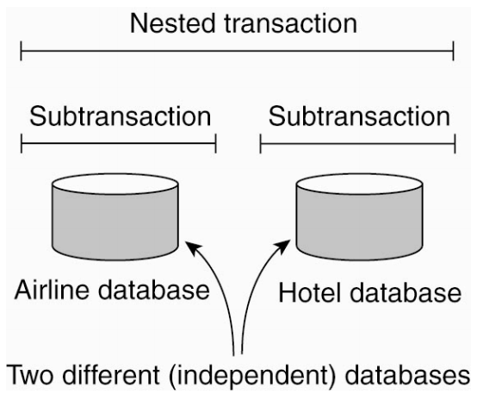
Nested Transactions

Slide 11
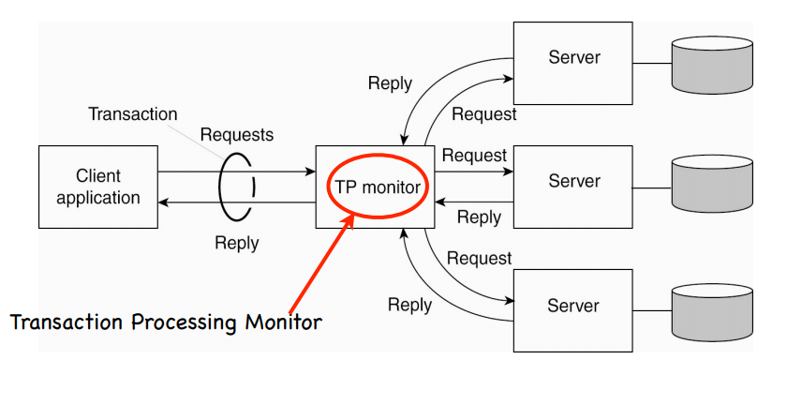
Realizing Transactions

Slide 12
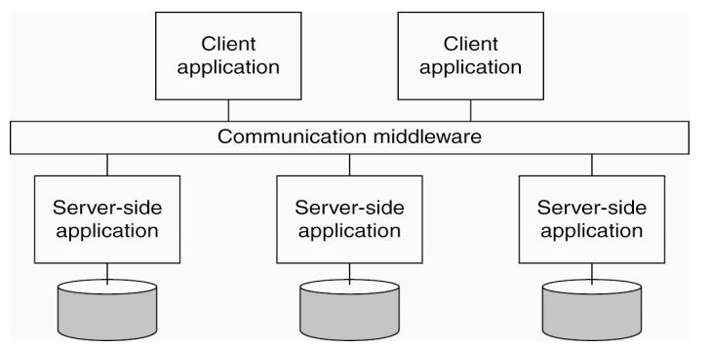
Enterprise Application Integration
Goal: link applications in a single organization together to simplify or automate the business process
Example: publish/subscribe systems
Middleware as a communication facilitator (RPC,RMI,MOM)

Slide 13
Distributed Pervasive Systems
Devices in a distributed pervasive system are often
Small, batter-powered, mobile, and limited wireless communication
Three characteristics
Embrace contextual changes
I was a phone and now I am a web access device
A device must be aware that its environment may change
Encourage ad hoc composition
Many devices will be used differently by different users
Recognize sharing as the default
Easy to read, store, manage, and share information

Slide 14
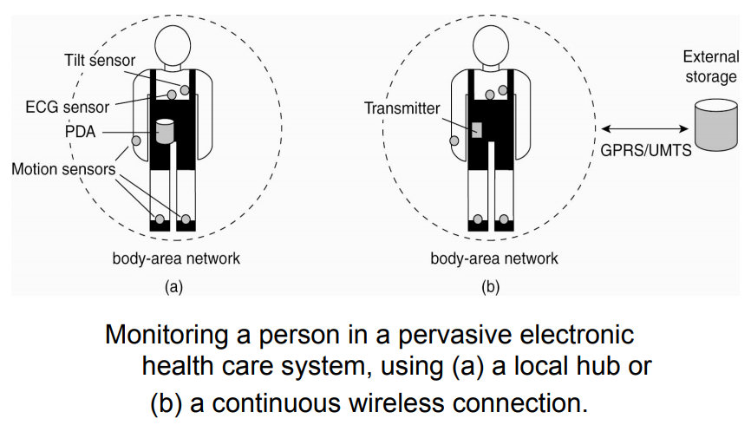
Electronic Healthcare Systems

Slide 15
Wireless Sensor Networks
A network that consists of a large number of low-end sensor nodes
Each sensor can sense the physical environments and
talk to other sensor nodes via short-range radio communication
Ideal candidate for applications that interact with environments
Infrastructure monitoring, battlefield surveillance
Some design questions to answer
How to efficiently route data in the network?
How to aggregate the results to reduce the communication?
What to do when network link fails

Slide 16
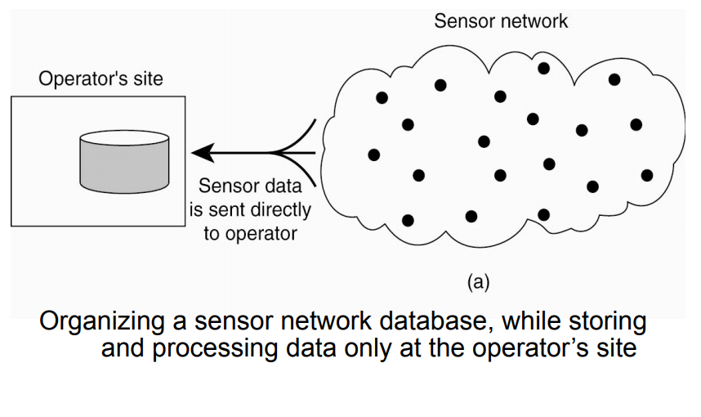
Wireless Sensor Networks

Slide 17
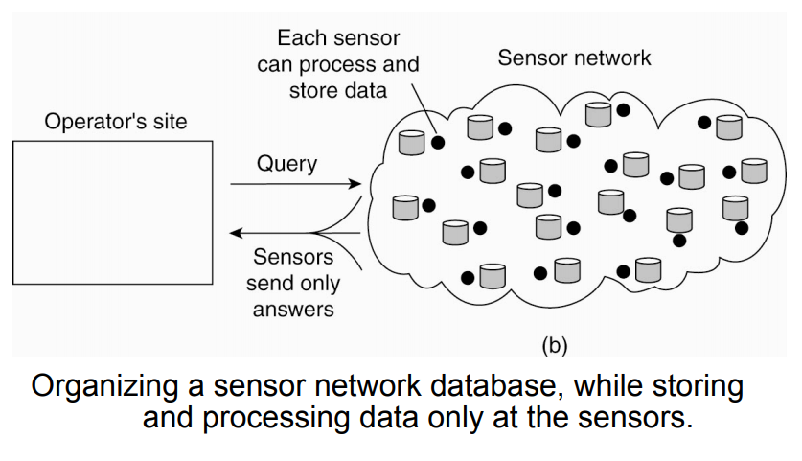
Wireless Sensor Networks

